Slide 1


Water Level Indicator
Rajsekhar Ganguli : 510614003

Slide 2
What is it?
The Water Level Indicator employs a simple mechanism to detect and indicate the water level in an overhead tank or any other water container.
Water tank overflow is a common problem which leads to the wastage of water. There are many mechanical solutions to it like ball valves which automatically stop the water flow once the tank gets full.
Here I have implemented an electronic circuit to solve the problem in a simple and efficient way, and also at low cost which will detect the water level and will raise an alarm upon getting the water tank full or at a preset level.

Slide 3
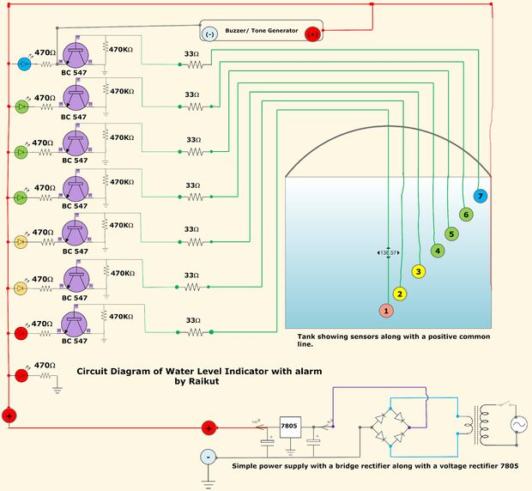
The Main Circuit

Slide 4
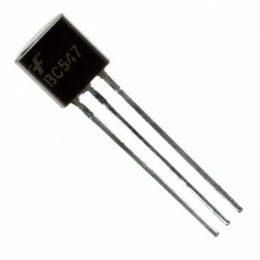
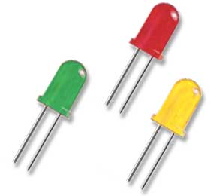

Circuit Components
5 - BC547 transistors
5- 470 ohm,5-470 Kohm,4-33 ohm,1 22 ohm resistor
5 - Colour LED
1 – Buzzer
5 volt dc regulated power supply
BC547
Carbon Film Resistor
LED

Slide 5
Circuit Introduction
This simple transistor based water level indicator circuit is very useful to indicate the water levels in a tank. Whenever tank gets filled, we get alerts on particular levels. Here I have created 5 levels for simplicity and convenience of circuit designing. However at the topmost level a buzzer is connected to make us aware of the overflow. The practical demonstration will be done using a cup of water.

Slide 6
Various Parts of the Circuit
There are 4 parts in the entire model:
The Sensor Part: It consists of a set of wires coming out of the main circuit which is in contact with water which is a good conductor of electricity due to the presence of dissolved salts and electrolytes.
The Circuit Part: It comprises the brain of the module. It has numerous transistors acting as a switch in the inverse mode (OFF during cut off and ON during saturation)connected in parallel, and the switch gets activated when the sensors are in contact with the water. The heart of the circuit is the transistors BC 547. There are total 5 transistors in the circuit and each one will be sensing the level of water present in the overhead water tank. Besides we shall also have a set of resistors in use which will limit the current and present improved performance.

Slide 7
The Power Supply: It is the part which converts the A/C voltage to a regulated voltage of 5V to the Circuit. This section contains a transformer converting the mains voltage 220V down to 6V. There is a bridge rectifier containing 4 diodes which convert the Alternating Current to Direct Current. After the filtering the voltage is then directly fed to the voltage regulator (LM7805CT) with a filtering capacitor. From the regulator IC the output voltage is then again filtered with a capacitor and is fed to the circuit.
The Buzzer: It is responsible for bringing up the sound when the water level fills up in the tank. It will also be having a speaker or a buzzer to alert.The buzzer basically works as a difference mode voltage amplifier and produces a sound only when the potential difference across it is close to 5V and that is achieved with the saturation of the top level transistor.

Slide 8
Making the 5 V Power Supply
In most of our electronic products or projects we need a power supply for converting mains AC voltage to a regulated DC voltage. The power supply I have made is done using the following components.
Step Down Transformer (230V to 6-0-6V)
Voltage Regulator (IC-LM7805CT)
Diodes (IN4007G)
Capacitors(2-470 µF, 2-47 µF).
The circuit diagram of the 5V regulated power supply created using Multisim
by National Instruments Inc. is given in the next slide.

Slide 9

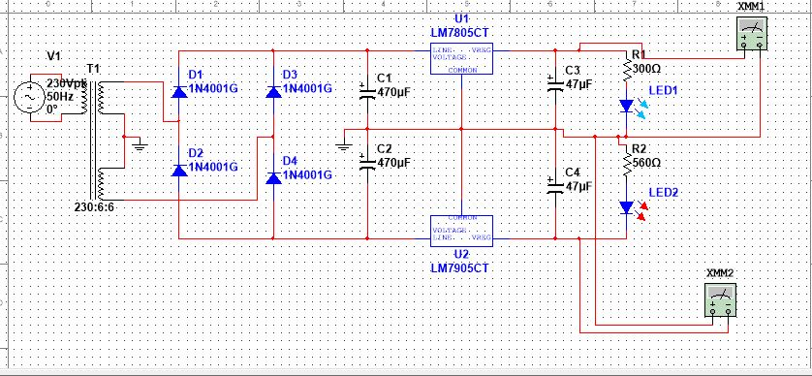
Circuit Diagram of 5 V Supply

Slide 10
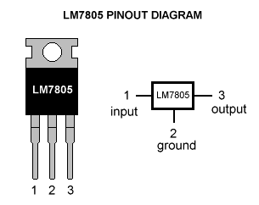
Components of the 5 V Power Supply
Voltage Regulator (IC-LM7805):
7805 IC Rating
Input voltage range 7V- 35V
Current rating I_{c =} 1A
Output voltage range V_{Max=5.2V ,}V_{Min=4.8V}
Diodes
4 IN4007 diodes are utilized to create a full-wave bridge rectifier. It is preferred over normal full wave rectifier as it has better TUF and better performance.
Capacitors
4 electrolytic capacitors- 2- 470µF and 2- 47µF used to improve the ripple factor of the rectifier.

Slide 11
Working Principle
Here I’m using transistor (of NPN type) as a Switch. Initially there is no voltage applied to the base of the Transistor Q1 and the transistor is in OFF state and no current is flowing through collector and emitter and LED is OFF.
When the water level reaches to Point 1 in the tank, the positive side of the battery gets connected to the base of the Transistor Q1 through the water. So when a positive voltage has been applied to the base of the Transistor Q1, it gets into ON state and current starts flowing from collector to emitter. And RED LED glows.

Slide 12
The resistor at the base of each transistor is used to limit the base current. Generally a transistor gets its ON state fully when a voltage difference of 0.7 V is applied to the base emitter junction. There are also resistors with each of the LEDs, to drop the voltage across LEDs, otherwise LED may blow up.
Same phenomenon happens when water level reaches to Point B. As soon as water level reaches to Point B, a positive voltage gets applied to the Transistor Q2, it gets ON and current started flowing through RED LED glows. With same principal, GREEN LED glow when water level reaches to Point D. And finally the buzzer beeps when water level reaches to E

Slide 13
Steps of Operation
There are 3 main conditions of operation
There is no water available in the source tank
Intermediate level
There is ample amount of water available in the source tank
Condition 1: Water not available
When the tank is empty there is no conductive path between any of the 5 indicating probes and the common probe (which is connected to +5V supply) so the transistor base emitter region will not have sufficient biasing voltage hence it remains in cut off region.

Slide 14
Condition 2: Intermediate Levels
Now as the water starts filling in the tank a conductive path is established between the sensing probes and the common probe and the corresponding transistors get sufficient biasing at their base.
In this project while the water level reaches the last level along with display in seven segment a discontinuous buzzer is activated which warns user that tank is going to be full soon.
Condition 3: Water Full
When the tank becomes full, the top level probe gets the conductive path through water and the corresponding transistor gets into conduction not only displays the level in seven segment display but also activates the continuous buzzer by which user can understand that tank is full and can switch off the motor and save water.

Slide 15
Water Level Indicator Project Circuit Features
Easy installation
Low maintenance
Compact elegant design
The Automatic water level controller ensures no overflows or dry running of pump there by saves electricity and water
Avoid seepage of roofs and walls due to overflowing tanks
Fully automatic, saves man power
Consume very little energy, ideal for continuous operation
Automatic water level controller provides you the flexibility to decide for yourself the water levels for operations of pump set
Shows clear indication of water levels in the overhead tank

Slide 16
Water Level Indicator Project Applications
Automatic Water level Controller can be used in Hotels, Factories, Homes Apartments, Commercial Complexes, Drainage, etc., It can be fixed for single phase motor, Single Phase Submersibles, Three Phase motors. (For 3Æ and Single Phase Submersible Starter is necessary) and open well, Bore well and Sump. We can control two motor and two sumps and two overhead tanks by single unit
Automatic water level controller will automatically START the pump set as soon as the water level falls below the predetermined level (usually 1/2 tank) and shall SWITCH OFF the pump set as soon as tank is full
Fuel level indicator in vehicles
Liquid level indicator in the huge containers in the companies

Slide 17
Information Credits
1.My respected professors of Electrical Engineering Department, IIEST Shibpur
2.http://circuitdigest.com/electronic-circuits/water-level-indicator-alarm-circuit 3.http://www.electronicshub.org/water-level-indicator 4. www.electroschematics.com/5764/simple-water-level-indicator-2/ 5. http://www.circuitsgallery.com/2012/10/water-level-sensor-circuit-projects-for.html 6. http://www.instructables.com/id/Water-Level-Indicator-with-Alarm 7. The books ‘Electronic Devices and Circuit Theory’ by Boylestad, ‘Integrated Electronics’ by Millman-Halkias & ‘Electronic Circuits’ by Mehta & Mehta

Slide 18
THANK YOU

